Slide 1

Density Based Traffic Control System Using Image Processing
Presented By: Jeevan H
(4NM16IS034)
Hemanth M
(4NM16IS031)
Ashwin Adiga
(4NM16IS017)
Adarsh B Patgar
(4NM16IS002)
8th Sem, ‘A’ section.
Guided By: Mr. Jason Elroy Martis
Asst. Professor
Mr. Santhosh
Asst. Professor

Slide 2
CONTENTS
INTRODUCTION
PROBLEM STATEMENT
IMPLEMENTATION
RESULTS
CONCLUSION & FUTURE SCOPE
REFERENCES

Slide 3
INTRODUCTION
As the population of modern cities is increasing day by day due to which vehicular travel is increasing which leads to the traffic problem.
Traffic has been causing many critical problems and challenges in the major and most populated cities. Due to this traffic congestion, there is more wastage of time.
The steady increase in the number of automobiles on the road has amplified the importance of managing traffic flow efficiently to optimize utilization of existing road capacity.
A camera will be installed It will capture image sequences. Image processing is a better technique to control the state change of the traffic. It shows that it can reduce traffic congestion and avoids the time being wasted by on an empty road.

Slide 4
PROBLEM STATEMENT
To design an efficient system for predicting traffic which overcomes the limitations of earlier traffic control system

Slide 5
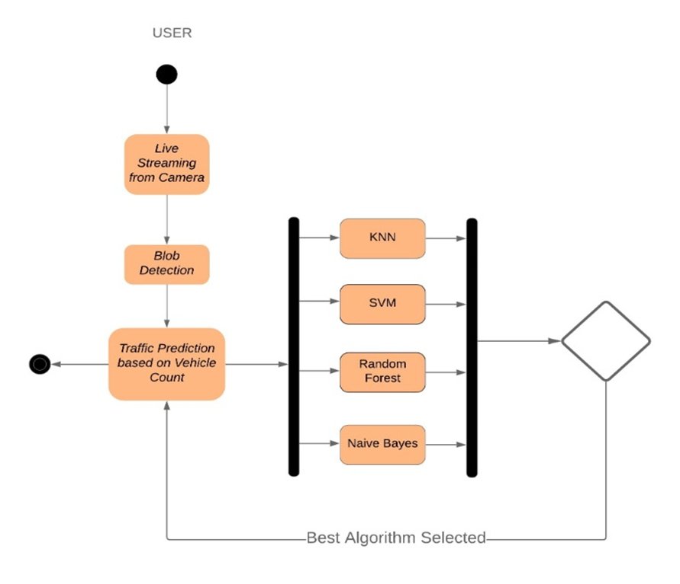
IMPLEMENTATION
I) ACTIVTY DIAGRAM

Slide 6
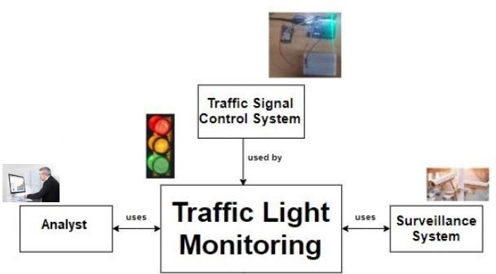
II) ARCHITECTURE DIAGRAM

Slide 7
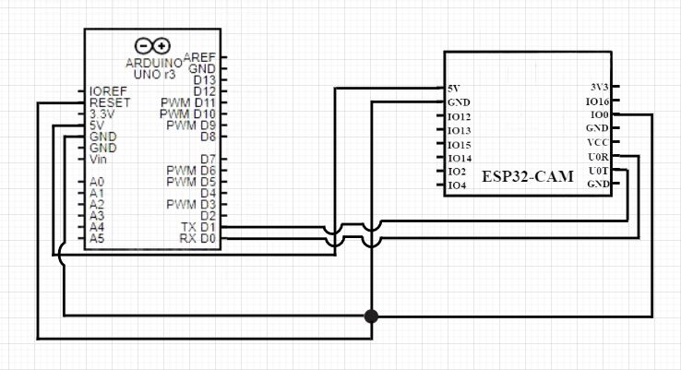
III) CIRCUIT DIAGRAM

Slide 8
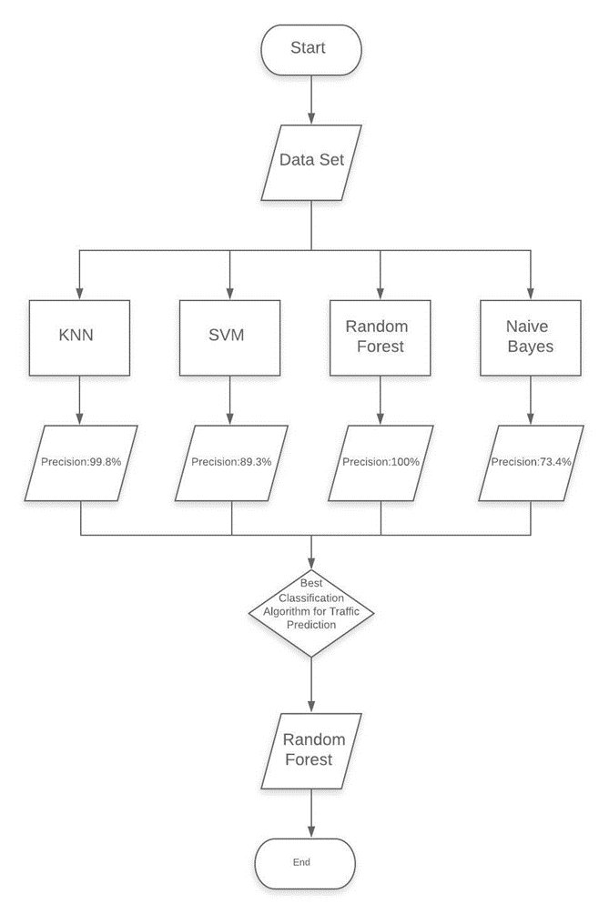
IV) FLOW CHART
Selection of Best Classification Algorithm for Traffic Prediction

Slide 9
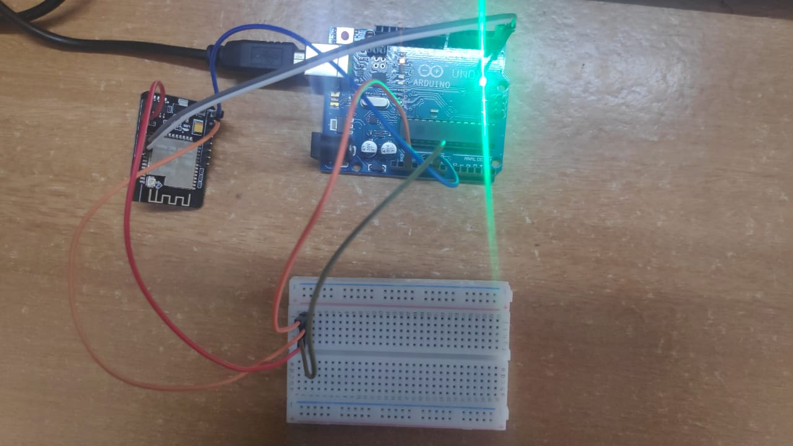
RESULTS
Fig. 1) WIRE CONNECTIONS OF THE SYSTEM

Slide 10
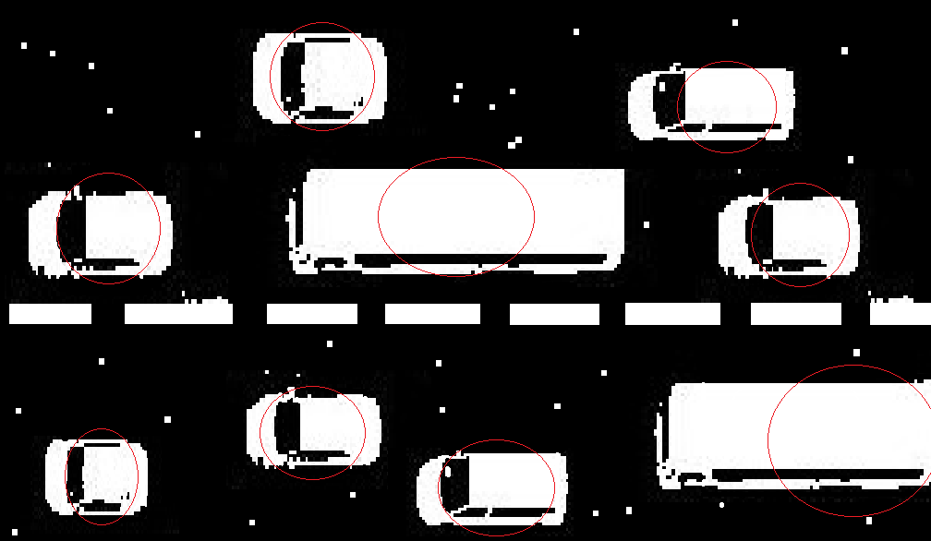
Fig. 2) BLOB COUNTING FOR THRESHOLD IMAGE

Slide 11
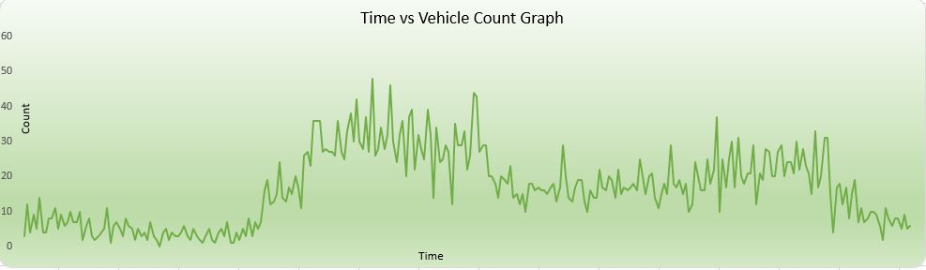
Fig. 3) TIME V/S COUNT GRAPH

Slide 12
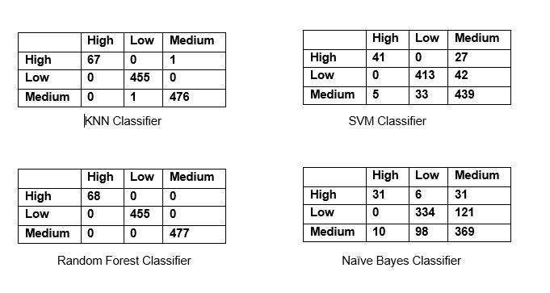
Fig. 4) CONFUSION MATRIX OF VARIOUS CLASSIFICATION ALGORITHMS APPLIED ON DATASET

Slide 13
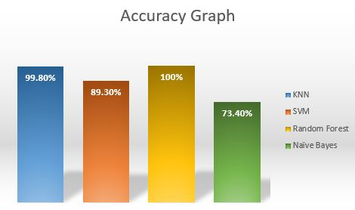
Fig. 5) ACCURACY GRAPH OF THE ALGORITHM APPLIED ON THE DATASET

Slide 14
CONCLUSION & FUTURE WORK
We have successfully attained the objective of implementing an efficient system for traffic prediction.
Upon comparison of various classification algorithms, we infer that Random Forest Classification gives the highest accuracy of 100% and can be considered as the most efficient algorithm for traffic prediction.
We can further implement this system to classify images even in low light condition by using any gamma correction technique or any other low light correction technique.
We have also not taken weather conditions into account which may affect the image quality when it becomes foggy or in heavy rains.

Slide 15
REFERENCES
[1] Harshini Vijetha H, Dr. Nataraj K R “IOT Based Intelligent Traffic Control System”, International Journal for Research in Applied Science & Engineering Technology (IJRASET), ISSN: 2321-9653, Volume 5 Issue V, May 2017.
[2] Vikramaditya Dangi, Amol Parab, Kshitij Pawar & S.S Rathod "Image Processing Based Intelligent Traffic Controller", Undergraduate Academic Research Journal (UARJ), ISSN: 2278 – 1129, Volume-1, Issue-1, 2012.
[3] Omkar Ramdas Gaikwad, Anil Vishwasrao, Prof. Kanchan Pujari, Tejas Talathi, “Image Processing Based Traffic Light Control”, International Journal of Science, Engineering and Technology Research (IJSETR) Volume 3, Issue 4, April 2014.
[4] N. J. Ferrier, S. M. Rowe, A. Blake, “Real-time traffic monitoring,” Proceedings of the Second IEEE Workshop on Applications of Computer Vision, pp.81 -88, 1994.
[5] Uthara E Prakash, Athira Thankappan, Arun A. Balakrishnan, “Density Based Traffic Control System Using Image Processing”, International conference on Emerging Trends and Innovations in Engineering and Technological Research (ICETIETR2k18) ISBN No 978-1-5386-5743-0.

Slide 16
[6] Ling Hu and Qiang Ni, “IoT-Driven Automated Object Detection Algorithm for Urban Surveillance Systems in Smart Cities”, DOI 10.1109/JIOT.2017.2705560, IEEE Internet of Things Journal.
[7] Ms. Pallavi Choudekar, Ms.Sayanti Banerjee, M K Muju, “Real Time Traffic Light Control Using Image Processing”, Indian Journal of Computer Science and Engineering (IJCSE), ISSN : 0976-5166 Vol. 2 No. 1.
[8] V. Parthasarathi, M Surya, B Akshay, K Murali Siva and Shriram K Vasudevan, “Smart Control of Traffic Signal System using Image Processing”, Indian Journal of Science and Technology, Vol 8(16), DOI: 10.17485/ijst/2015/v8i16/64622, July 2015. ISSN: 0974-5645.
[9] Chirag Thakkar, Rajesh Patil, “Smart Traffic Control System Based on Image Processing”, International Journal for Research in Applied Science & Engineering Technology (IJRASET), ISSN: 2321-9653, Volume 5 Issue VIII, July 2017.
[10] J. Vijayaraj, Dr. D. Loganathan, “Traffic Congestion Control of Vehicle Based on Edge Detection Using Image Processing”, International Journal of Pure and Applied Mathematics Volume 119 No. 14 2018, 1407-1418 ISSN: 1314-3395.
[11] Rahishet, Aparajita Sahoo, Aparna Indore, Vaibhavdeshmukh, Pushpa U S, “In- telligent Traffic Light Control Using Image Processing”, Proceedings of 21st IRF International Conference, 8th March 2015, Pune, India, ISBN: 978-93-82702-75- 7.

Slide 17
THANK YOU

